Slide 1
Black Lives Matter
Social Media Analytics
Ali Al Samuraee
Mesaye Bahiru
Cristina Esposito
Alya Gabsi
Gayatri Krishnamoorthy

Slide 2

Racism in America
The United States of America encounters a disproportionate criminal justice system, where from arrest through sentence to death row, Black and Latino males are heavily represented.
According to a new study conducted by Frank Edwards, of Rutgers University’s School of Criminal Justice, African Americans are 2.5 times more likely than whites to be slain by police.
2/26/2012: George
Zimmerman shoots
Trayvon Martin In Sanford, FL
#BlueLivesMatter came into light as a response to the BLM movement after the jury decided not to indict NYPD officer Daniel Pantaleo
Stephon Clark gets shot in Sacramento, CA
George Floyd was killed in Police Custody
2012 - 2013
2014 - 2015
2016-2020
2020-2021
#BlackLivesMatter is a movement founded by three Black women in 2013 - Alicia Garza, Patrisse Cullors, and Opal Tometi.
Breonna Taylor gets shot in Louisville, KT
Black Lives Matter protests nationwide
Ahmaud Arbery gets shot in Brunswick, GE in his morning jog
Notes:
Gayatri: 45 sec

Slide 3

Project Overview
NETWORK ANALYSIS
#BLACKLIVESMATTER
30,000 Tweets (5k per period and hashtag) in 2020
Pre: 16th to 23rd of May During: 7th of June After: 21st of June | Pre: 2nd to 23rd of May During: 6th and 7th of June After: 18th to 21st of June
NETWORK ANALYSIS
#BLUELIVESMATTER
COMMUNITY DETECTION
Community detection analysis during blue lives matter movement
TOXICITY ANALYSIS
Perspective API that uses machine learning to identify “toxic" comments
SWEAR WORDS ANALYSIS
Using statistical inference & frequency table
NEXT STEPS
Enhancement to the project
Notes:
Gayatri: 30 seconds

Slide 4
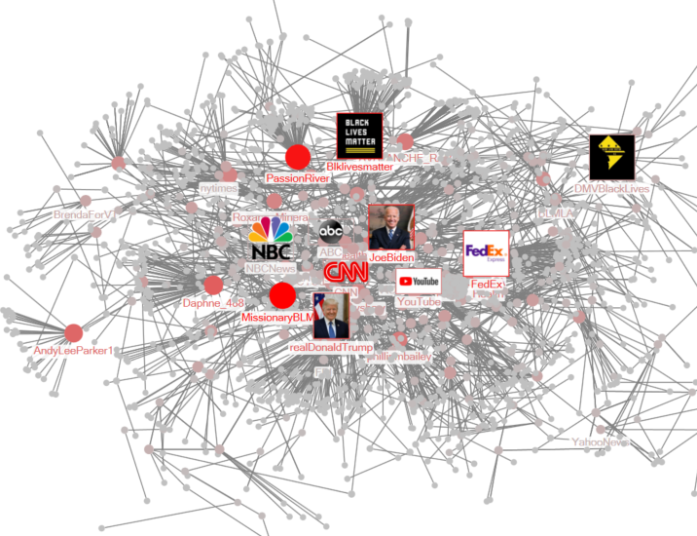
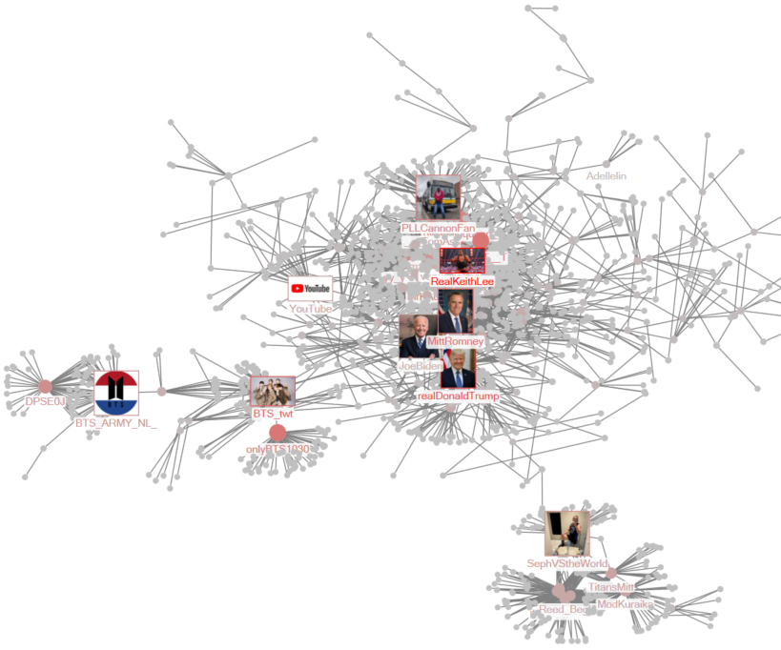
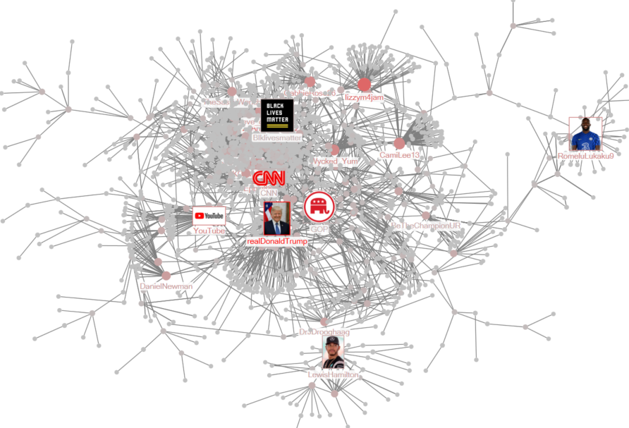
Network Analysis – Black lives matter
Pre movement
During the movement
Post movement
Network Evolution from prior to post movement
 | Pre | During | Post
Highest Degree | MissionaryBLMM | RealKeithLee | realDonaldTrump
Highest Betweenness | JoeBiden | realDonaldTrump | realDonaldTrump
Highest Pagerank | MissionaryBLMM | RealKeithLee | realDonaldTrump
Controversial tweets and retweets
Pro law enforcement
Threatened to bring in military to stop protests
Notes:
Cristina: 2 min

Slide 5
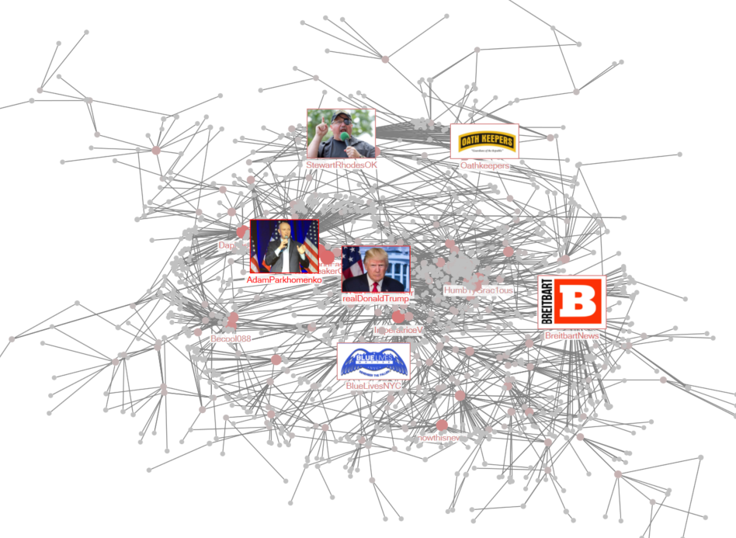
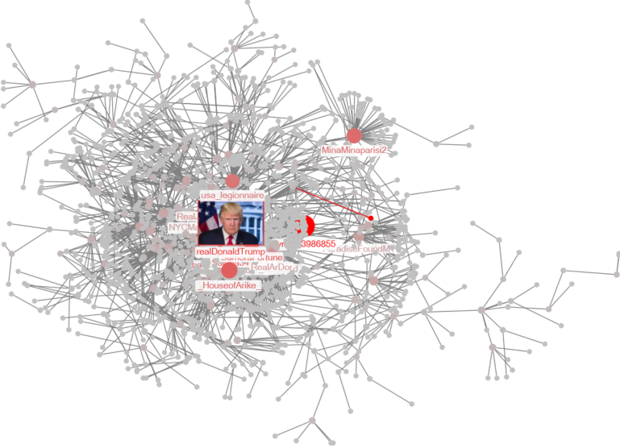
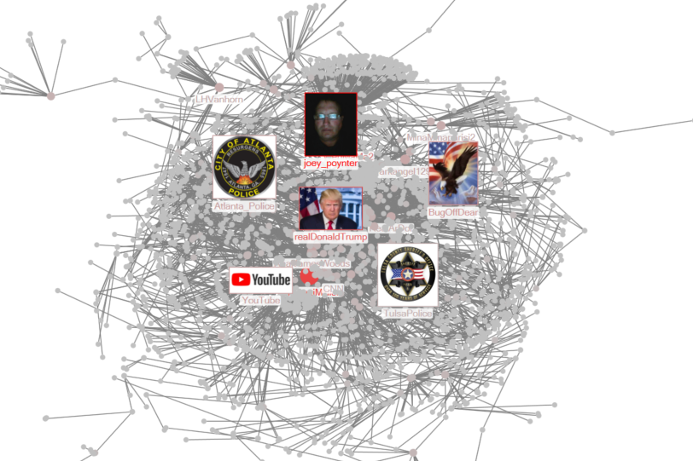
Network Analysis – Blue lives matter
Pre movement
During the movement
Post movement
Network Evolution from prior to post movement
 | Pre | During | Post
Highest Degree | AdamParkhomenko | Lynda63986855 | joey_poynter
Highest Betweenness | realDonaldTrump | realDonaldTrump | realDonaldTrump
Highest Pagerank | AdamParkhomenko | Lynda63986855 | joey_poynter
Who is Lynda63986855 ?
Notes:
Mesaye: 1 min

Slide 6
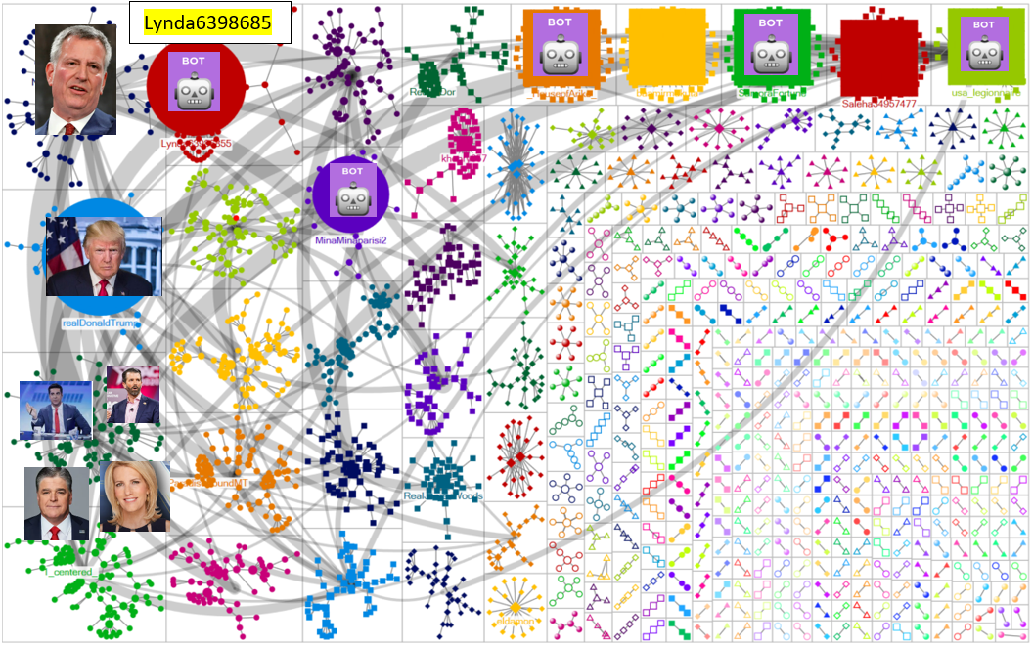
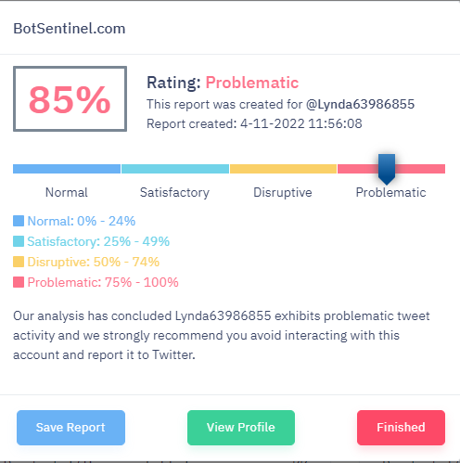
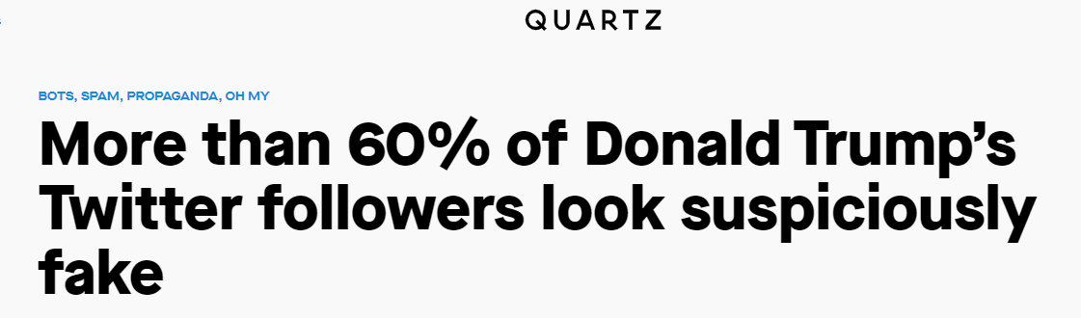
Community Detection Analysis –Blue lives
Applied Girvan-Newman algorithm
To isolate clusters within the networks
Identify patterns, characteristics, and stance in the network linked to suspected fake accounts
Notes:
Mesaye: 1 min

Slide 7
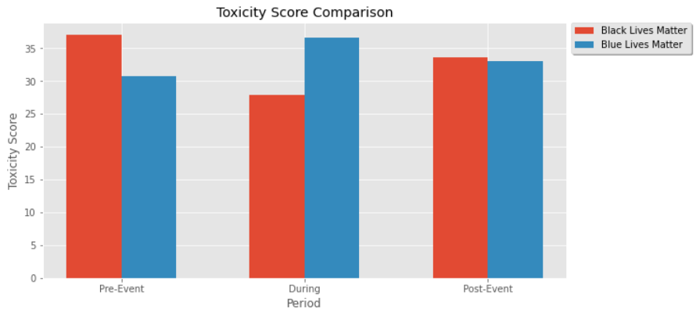
Toxicity Analysis
Goal: Which movement has the most hate speech on Twitter?
Objective: Calculating average toxicity score per period
Conclusion & Thoughts:
Pre-Event: BLM had a more violent speech as supporters were condemning crimes against black folks.
During Period: BLM tone changed as they were seeking solidarity considering the peak moment of the issue. In response, Blue LM toxicity increased by 19% to push back against the growing amplitude of the movement.
Post-Event: BLM's toxicity increased by 20% as a response to the violence exerted by blue live matters suporters.
Notes:
Alya:1m30

Slide 8
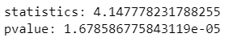
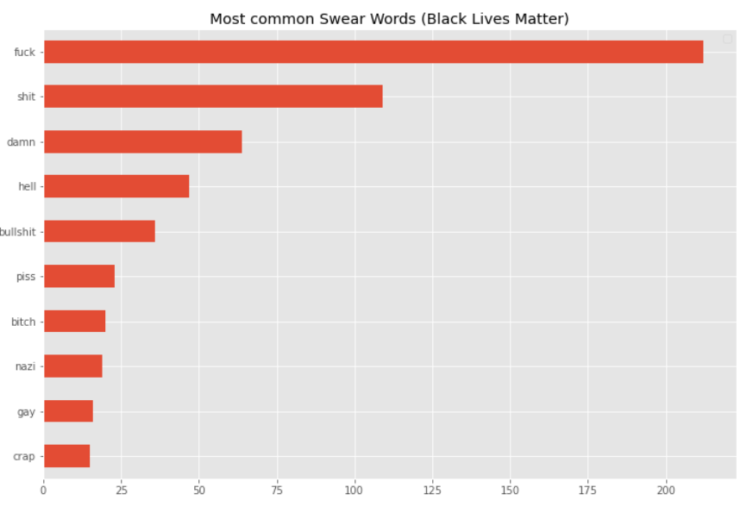
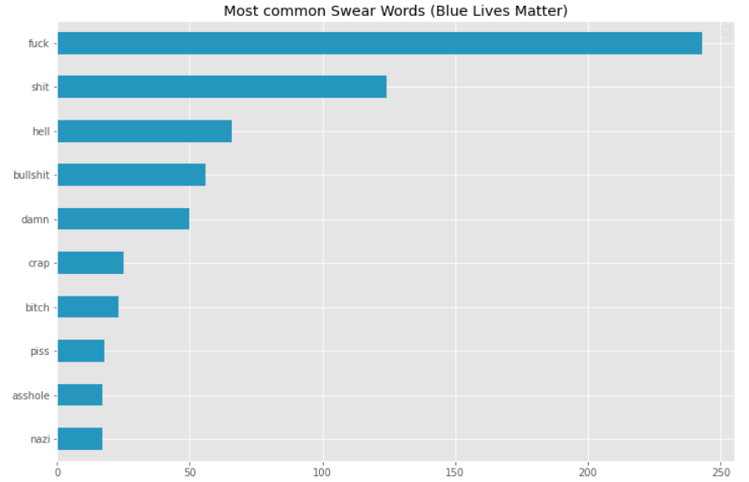
Swear Word Analysis
Goal: Which movement uses swear words the most? What are the most common swear words for each movement?
Objective: Using statistical inference & frequency table
1
The result is statically significant.
Blue LM swear more than BLM at a 5% level
2
Notes:
Ali:1 min

Slide 9
Next Steps & Enhancement
Get a larger dataset with several days (continuous days)
Alter periods to validate variation
Compare network analysis with other movements such as Capitol Invasion
Notes:
Ali: 20 seconds

